Slide 1
Software Lab Project
CSE-1211
Project name: Sky Roads.
Submitted to:
1. Dr. Muhammad Asif Hossain Khan
Associate Professor, Dept of CSE.
2.Ms. Anna Fariha
Lecturer, Dept of CSE.
Submitted by:
1.Tanzir Islam- (FH-01)
2.Shahreen Salim Aunti- (SN-33)

Slide 2
Introduction, the game and discussion on working procedure

Slide 3
Sky Roads
Our project was to create a futuristic racing game called “Sky Roads”.
It is a replica version of the renowned game “Skyroads” developed by Bluemoon Software in 1993.
The game starts when the player starts to move forward.
The game ends when the player completes a level without any collision with obstacles on the road and keeping the aircraft on track the full time.

Slide 4
Why Sky Roads?
We thought of doing something different.
Actually pretty much everyone played this game.

Slide 5
Main features
The main features of this project are:
Programmed in C++ and simple BGI( Borland Graphics Interface) functions were used.
The compiler is Microsoft Visual C++ 2010.
Single player game.
Keyboard controlled game.
The player has to use only space bar and direction keys to perform certain moves.
The game has two levels. One is easy and another is comparatively difficult.

Slide 6
Additional features
The player can choose any one level to start the game.
Necessary instructions are included to make things easier.
The leader board contains the best 10 players.

Slide 7
Our working procedure
As our game is not a logic-based game, we didn’t have to follow any definite algorithm.
We applied brute force.
For instance: when the player makes the aircraft jump, we even checked if the jump was accurate enough to surpass the obstacle. By accuracy we mean distance from the obstacle and perfect timing.

Slide 8
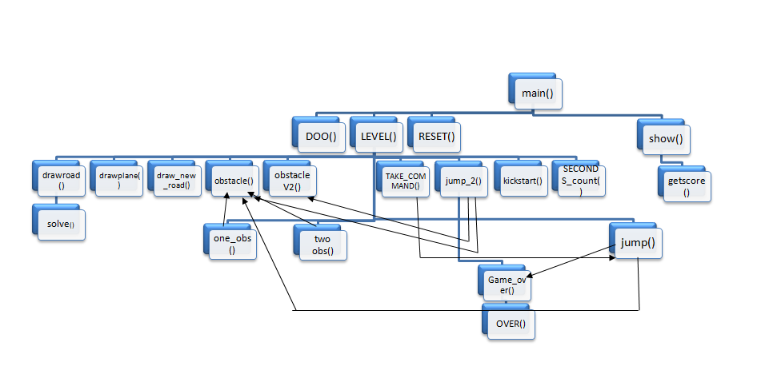
Diagram of functions:

Slide 9
Graphical portion
To create the graphical interface, we use BGI (Borland Graphics Interface).
Our game is dependent on the graphical interface. So we had to work on the graphical portion first.
Our game shows a 3D perspective to the players and so we had to draw our roads and backgrounds in accordance with necessity.

Slide 10
A quick overview on the project interface

Slide 11
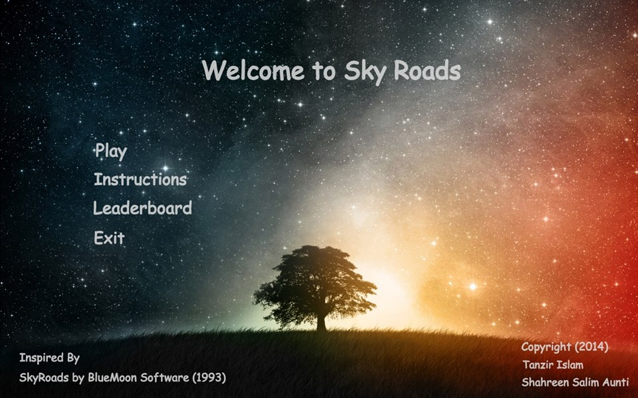
Game menu

Slide 12
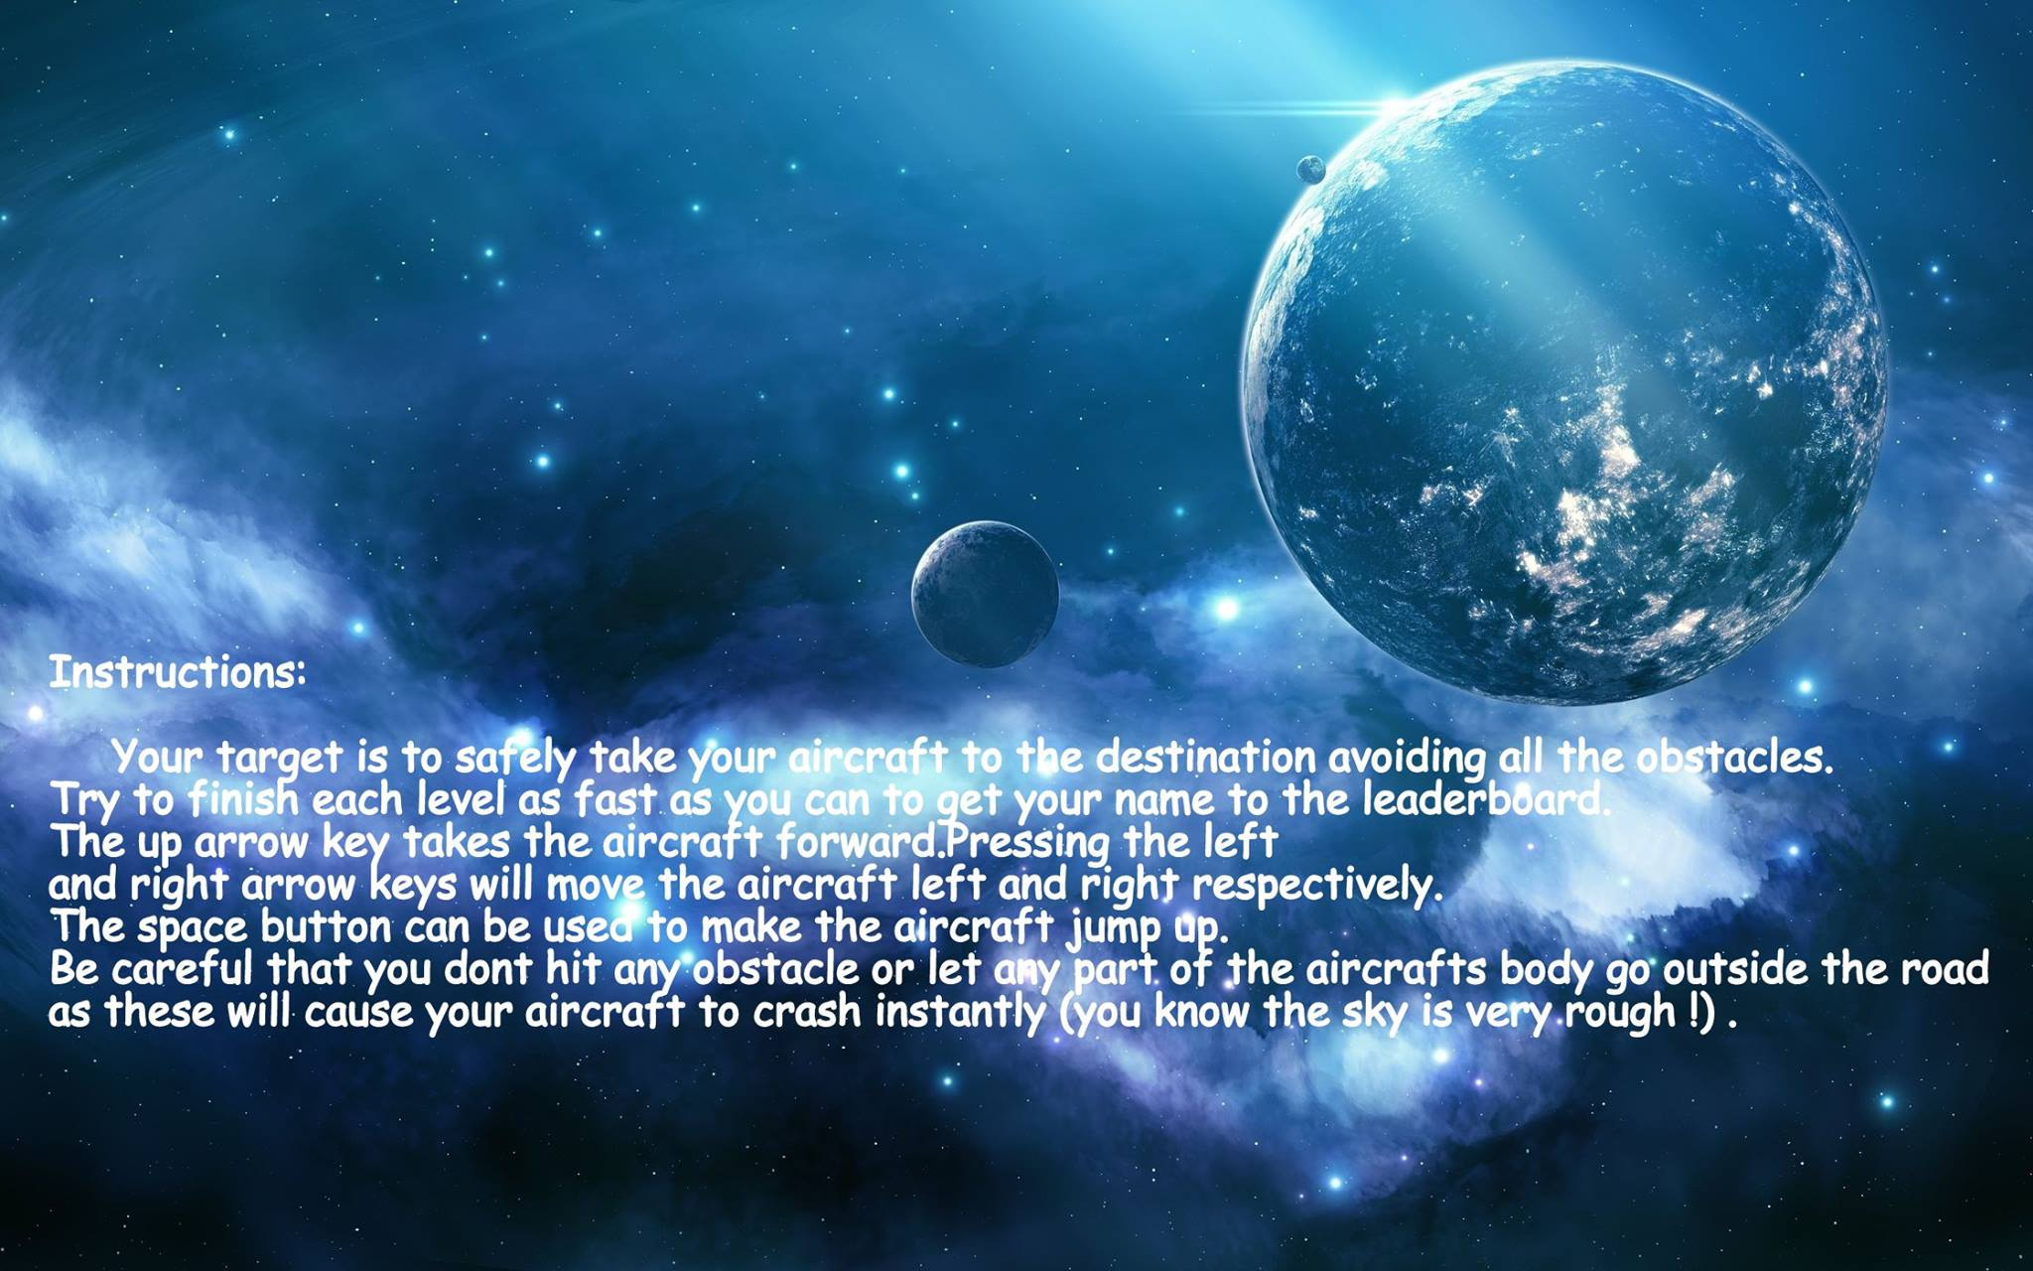
Game instructions

Slide 13
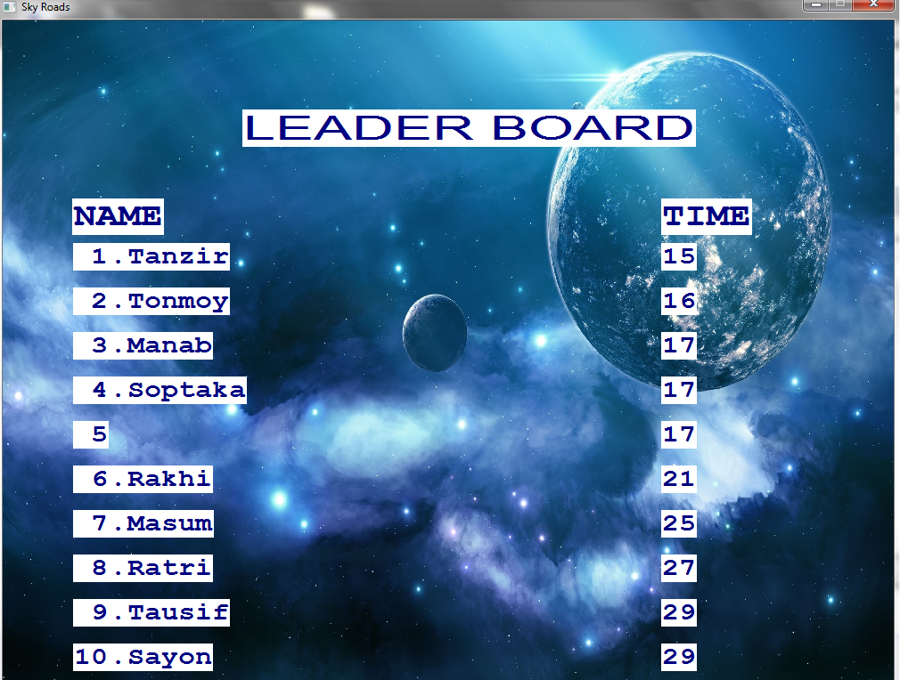
Leader board

Slide 14

Levels

Slide 15
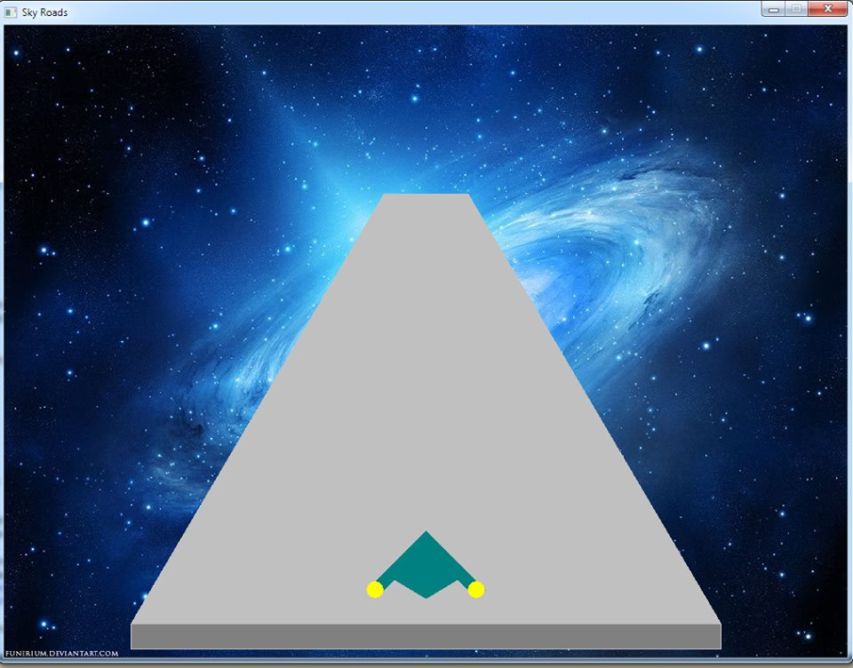
Condition before starting

Slide 16




OBJECTS used
Aircraft
Obstacles

Slide 17
Difficulties faced,Limitations, and discussion on utility

Slide 18
Difficulties faced
We had to be careful about various corner cases.
Unwanted drawbacks remained.
The whole idea of presenting a 3D perspective in a 2D computer monitor screen was complicated.

Slide 19
limitations
We managed to include only two levels.
As we know BGI is not a standard graphical interface and it has certain limitations.
We tried our best to present a 3D perspective to the players but it was not so easy while using BGI functions.
The keyboard buffering issues

Slide 20
Utility of this project
There is hardly any person who hasn’t played this game in their childhood.
It is an interesting game.
It will make you feel nostalgic and feel like you tried something new at the same time.

Slide 21
references
www.bluemoon.ee/history/skyroads/
www.cs.colorado.edu/~main/bgi/doc/
en.wikipedia.org.

Slide 22
Thank you

